Slide 1
The Citric acid cycle
4/16/2003

Slide 2
The Citric acid cycle
It is called the Krebs cycle or the tricarboxylic and is the “hub” of the metabolic system. It accounts for the majority of carbohydrate, fatty acid and amino acid oxidation. It also accounts for a majority of the generation of these compounds and others as well.
Amphibolic - acts both catabolically and anabolically
3NAD+ + FAD + GDP + Pi + acetyl-CoA
3NADH + FADH + GTP + CoA + 2CO₂

Slide 3
History
By 1930 it was established that the addition of lactate, acetate succinate, malate, α-ketoglutaric acid (dicarboxylic acids) and citrate and isocitrate (tricarboxylic acids) when added to muscle mince that they stimulated oxygen consumption and release of CO₂
1935Albert Szent-Gyorgyi showed that
Succinate Fumarate Malate Oxaloacetate
Carl Martius and Franz Knoop showed
Citrate cis-aconitate isocitrate α ketoglutarate
succinate fumarate malate oxaloacetate

Slide 4
Martius and Knoop showed that pyruvate and oxaloacetate could form citrate non-enzymatically by the addition of peroxide under basic conditions.
Krebs showed that succinate is formed from fumarate, malate or oxaloacetate. This is interesting since it was shown that the other way worked as well!!
Pyruvate can form citrate enzymatically
Pyruvate + oxaloacetate citrate + CO₂
The interconversion rates of the intermediates was fast enough to support respiration rates.

Slide 5
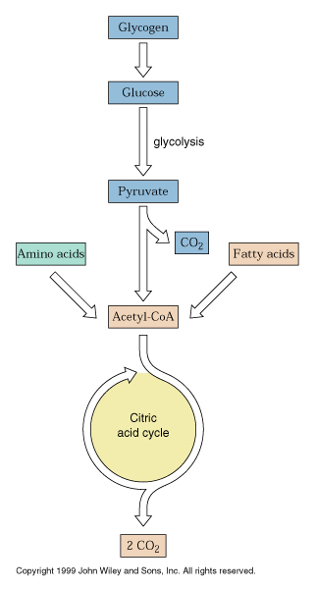
Overview

Slide 6
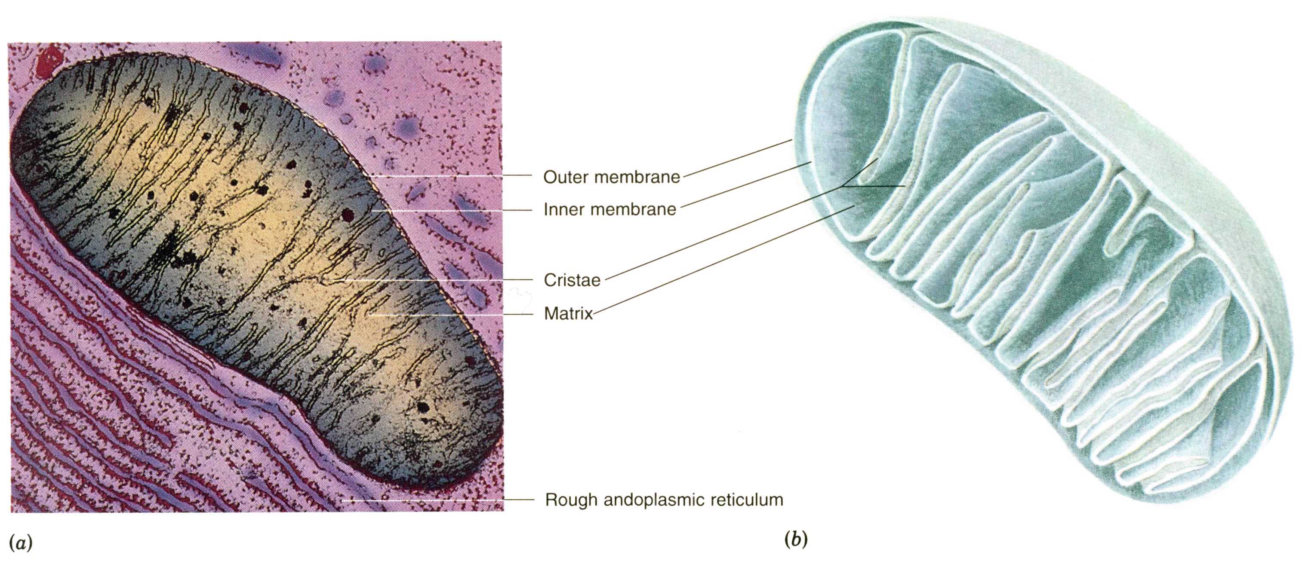
The citric acid cycle enzymes are found in the matrix of the mitochondria
Substrates have to flow across the outer and inner parts of the mitochondria

Slide 7
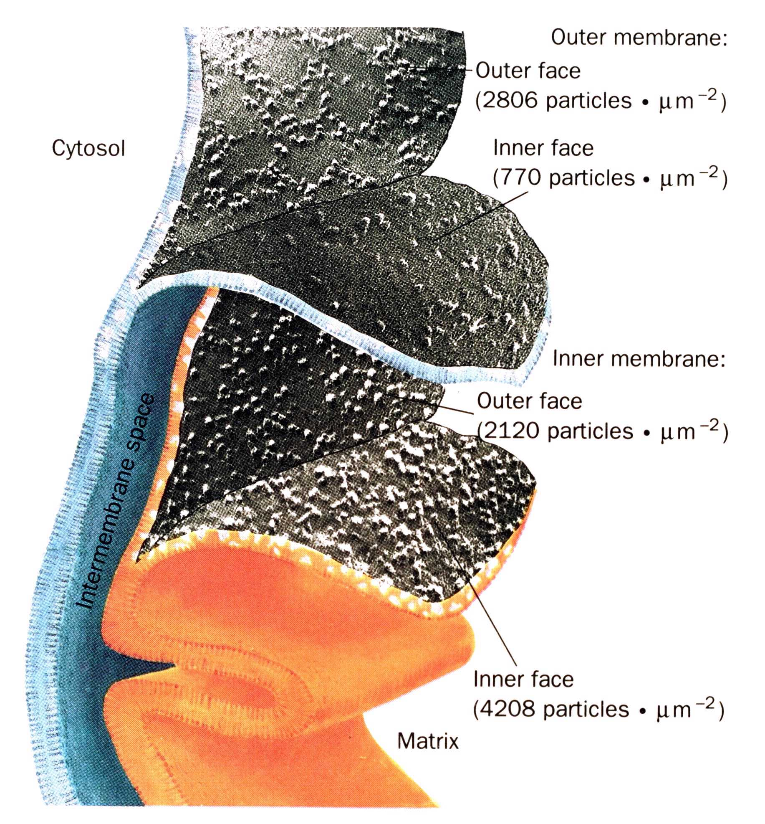

Slide 8
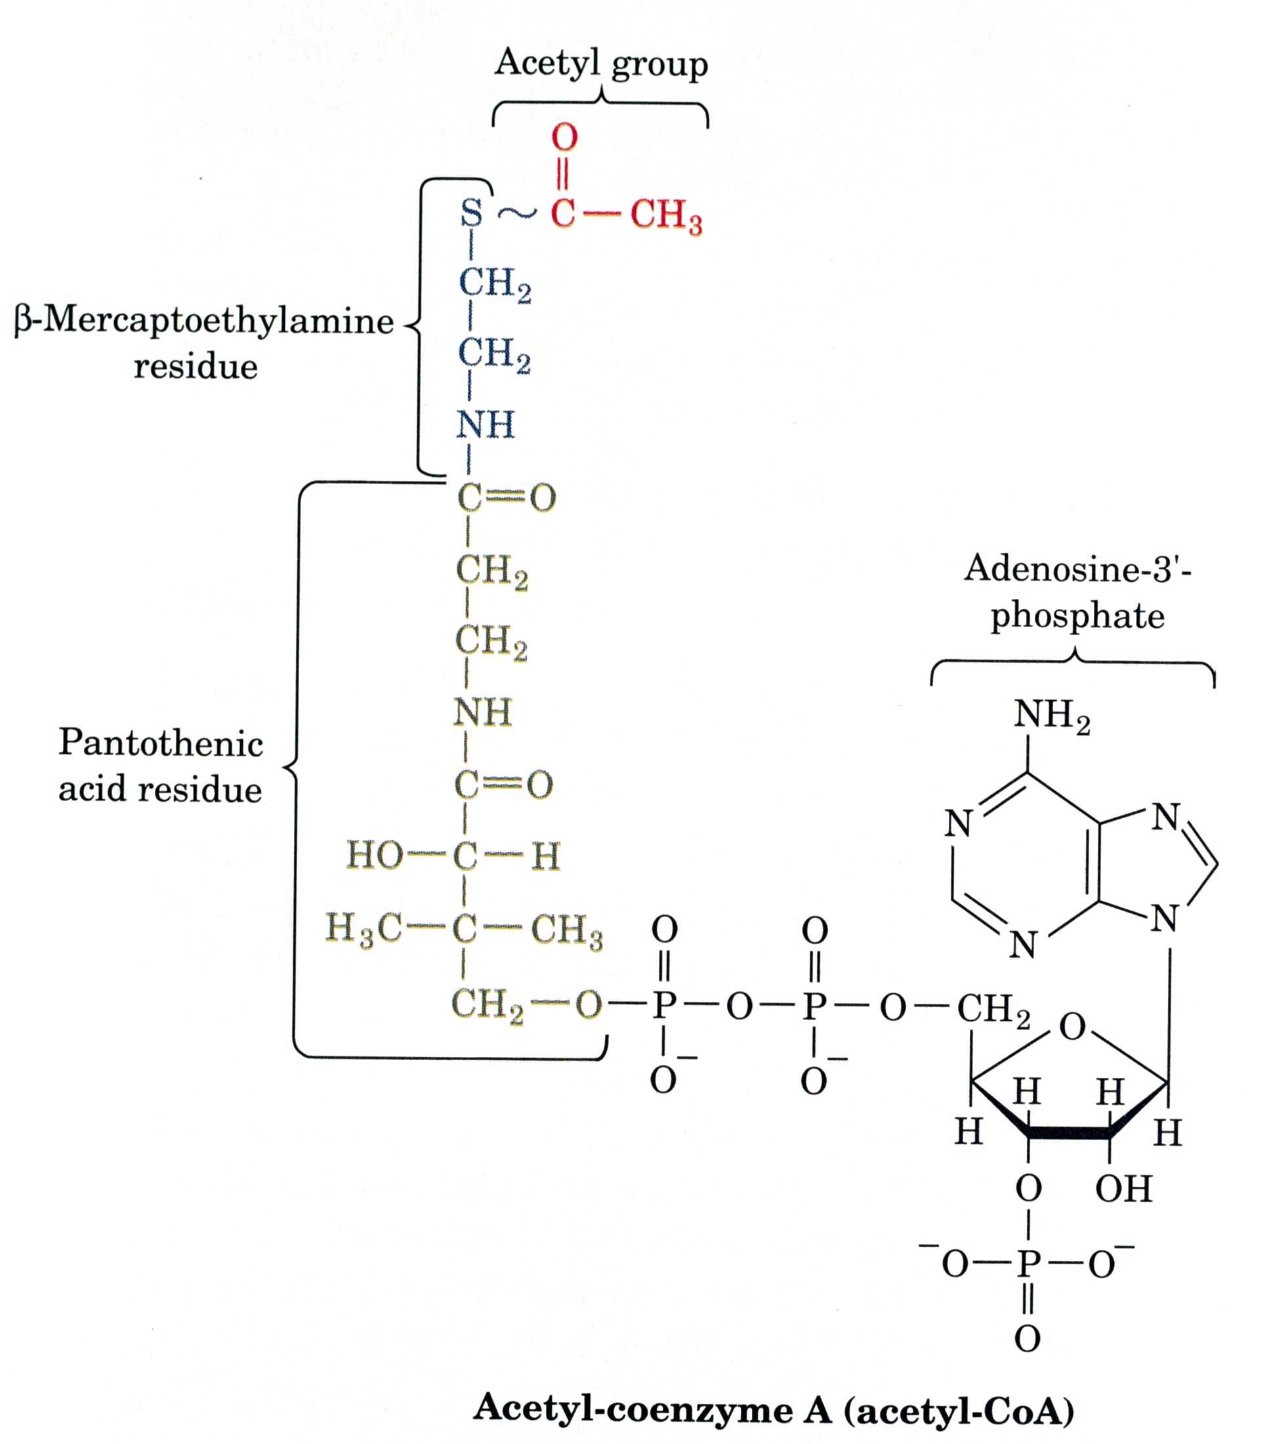
Nathan Kaplan and Fritz Lipmann discovered Coenzyme A and Ochoa and Lynen showed that acetyl-CoA was intermediate from pyruvate to citrate.

Slide 9
